Slide 1
Chapter 5: Domain Modeling
Part 1 – UML Class Diagram

Slide 2
Key Takeaway Points
Domain modeling is a conceptualization process to help the development team understand the application domain.
Five easy steps: collecting information about the application domain; brainstorming; classifying brainstorming results; visualizing the domain model using a UML class diagram; and performing inspection and review.
5-<number>

Slide 3
Domain Modeling in the Methodology Context
Business goals
& needs
Current situation
Use case-iteration allocation matrix
Accommodating
Requirements Change
Customer
feedback
Acquiring
Requirements
(Domain Modeling)
Iteration use cases
Domain Modeling
Preliminary requirements
Domain model
Domain model
Deriving Use Cases
from Requirements
Actor-System Interaction Modeling
Abstract & high level use cases, use case diagrams
Expanded use cases & UI design
Allocating Use Cases & Subsystems
to Iterations
Behavior Modeling &
Responsibility Assignment
Behavior models
Use case-iteration allocation matrix
Deriving Design Class
Diagram
Producing an Architecture Design
Design class diagram
Software architecture
Test Driven Development, Integration, & Deployment
(a) Planning Phase
(b) Iterative Phase – activities during each iteration
control flow
data flow
control flow & data flow
5-<number>

Slide 4
What Is a Model?
A conceptual representation of something.
A schematic description of a system, theory, or phenomenon that accounts for its known or inferred properties and may be used for further study of its characteristics. (Dictionary Definition)
5-<number>

Slide 5
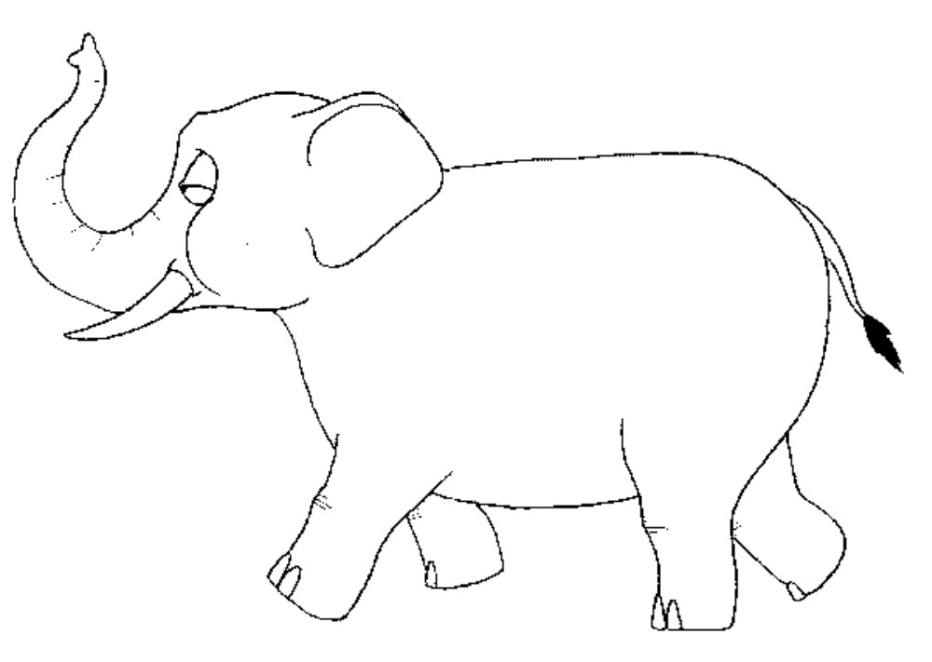




Why Do We Need Model?
No, you are all wrong. Elephant is like a fan.
An ancient Chinese story. How four blind men perceive an elephant.
Elephant is like a wall.
No, elephant is like a rope.
No, I think elephant is a cylinder.
We perceive the world differently due to differences in backgrounds and viewpoints. Modeling facilitate collective understand of the application.
5-<number>

Slide 6
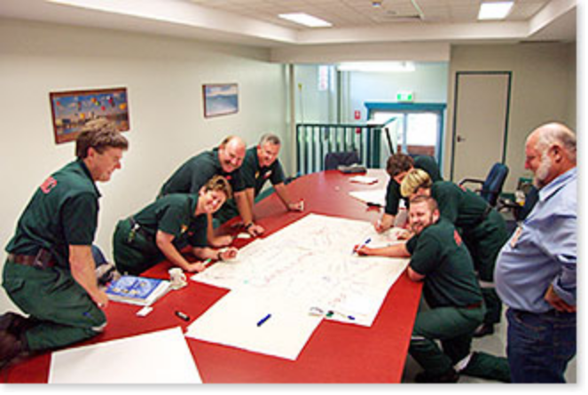
Why Do We Need Model?
Because the team members and the users need to
communicate their perception about a piece of reality.
A model facilitates the team members and users to
communicate their perception and design ideas.
5-<number>

Slide 7

Why Do We Need Models?
Because we need models during the maintenance phase to perform enhancement maintenance.
5-<number>

Slide 8
Domain Modeling
What:
  A process that helps the team understand the application or application domain.
  It enables the team to establish a common understanding.
Why:
  Software engineers need to work in different domains or different projects. They need domain knowledge to develop the system.
  Software engineers come from different backgrounds, which affect their perception of the application domain.
How:
  Collect domain information, perform brainstorming and classification, and visualize the domain knowledge using a UML class diagram
5-<number>

Slide 9
Domain Modeling
A domain model defines application domain concepts in terms of classes, attributes and relationships.
The construction of the domain model
  helps the development team or the analyst understand the application and the application domain
  lets the team members communicate effectively their understanding of the application and the application domain
  improves the communication between the development team and the customer/user in some cases
  provides a basis for the design, implementation and maintenance
Domain model is represented by UML class diagrams (without showing the operations).
5-<number>

Slide 10
Domain Modeling in the OO Paradigm
The OO paradigm views the real world as consisting of
  objects
  that relate to each other, and
  interact with each other
The basic build blocks and starting point are objects.
5-<number>

Slide 11
Important Object-Oriented Concepts
Class
--- a class is a type
an abstraction of objects with similar properties and behavior
an intentional definition of a collection of objects
Attribute
--- define properties of class of objects
Operation
--- define behaviors of class of objects
Object
--- an instance of a class
--- defining/storing together properties and behavior of a class/object
Encapsulation
5-<number>

Slide 12
Important Object-Oriented Concepts
Information hiding
--- shielding implementation detail to
reduce change impact to other part of a program
Polymorphism
--- one thing can assume more than one form
5-<number>

Slide 13
Represent Domain Model as UML Class Diagram
UML class diagram is a structural diagram.
It shows the classes, their attributes and operations, and relationships between the classes.
Domain model is represented by a class diagram without showing the operations.
5-<number>

Slide 14
UML Class Diagram: Notion and Notation
Class: a type (in OO)
Class Name
Class Name
Attribute
compartment
Attributes of class
Operation
compartment
Operations of class
Compact view
Expanded view
Example:
Employee
Employee
SSN
name
checkIn(time)
checkOut(time)
5-<number>

Slide 15
Representing Type in UML
attribute name
Employee
SSN: char*
attribute type
name: char*
checkin(time:float):void
return type
checkout(time:float):void
function name
parameter name
parameter type
general syntax name : type
5-<number>

Slide 16
Inheritance Relationship
It expresses the generalization / specialization relations between concepts.
One concept is more general/specialized than the other.
Example: vehicle is a generalization of car, car is a specialization of vehicle.
It is also called IS-A relation.
Vehicle
model#
horse power
manufacturer
start()
drive()
Car
drive()
Boat
drive()
5-<number>

Slide 17
Example: Inheritance
superclass, it is
more general
User
id: char*
name: char*
login(id, password)
logout()
triangle pointing to
the super-class.
subclass, more specific
Staff
Student
processApplication()
applyOnline()
A staff is a user, a student is a user.
subclass may have dditional features
Features (i.e., attributes and operations) defined
for the super-class are automatically defined for the subclasses.
5-<number>

Slide 18
Object and Attribute
A noun/noun phrase can be a class or an attribute, how do we distinguish?
This is often a challenge for beginners.
Rules to apply:
An object has an "independent existence" in the
application/application domain, an attribute does not (have).
Example: "Number of seats", class or attribute?
Attribute, because "number of seats" cannot exist without
referring to a car, airplane, or classroom as in
"number of seats of a car"
"number of seats of a classroom"
5-<number>

Slide 19
Object and Attribute
Rules to apply:
  Attributes describe objects or store state information of objects.
  You can enter an attribute (value) from the keyboard, but you cannot enter an object.
  Objects must be created by invoking a constructor (explicitly or implicitly).
5-<number>

Slide 20
Two Tests for Inheritance
IS-A test: every instance of a subclass is also an instance of the superclass.
Conformance test: relationships of a superclass are also relationships of subclasses.
Engine
model#
horse power
manufacturer
start()
stop()
Professor
name
phone
teach(...)
Retirement Plan
enroll
Car is not an engine.
Visiting Professor
signContract()
Car
drive()
Visiting professors cannot enroll in a retirement plan at the host university.
5-<number>

Slide 21
Aggregation Relationship
It expresses the fact that one object is part of another object.
Example: engine is part of a car.
It is also called part-of relationship.
Car
model#
horse power
manufacturer
start()
stop()
part-of relationship
Engine
model#
horse power
manufacturer
start()
stop()
5-<number>

Slide 22
Association Relationship
It expresses a general relationship other than inheritance and aggregation.
These can be application specific relationships between two concepts.
Example: "instructor teach course," "user has account."
Professor
name
phone
teach(...)
Retirement Plan
enroll
Enroll is not an inheritance or aggregation relationship.
5-<number>

Slide 23
Role and Association Direction
association
name
association
direction
Student enrolls in Course
enroll 8
Student
Course
student
course
course
5
teach
Faculty teaches Course
instructor
Faculty
role name
5-<number>

Slide 24
Role and Multiplicity
Another employee is the
worker.
Employee supervises other
employees.
worker
supervise
*
Employee
supervisor
A supervisor supervises
zero or more employees.
An employee is the
supervisor.
5-<number>

Slide 25
Multiplicity Assertion/Constraint
multiplicity
Base Station
Mobiles
# Of Channels
location
1
network id#
location
phone#
service
*
One base station services zero or more mobiles and
every mobile is serviced by exactly one base station.
Other multiplicity constraints:
1 exactly one (default) 1..* one or more
0..1 zero or one m..n m to n
*, 0..* zero or more n exactly n
5-<number>

Slide 26
Summary: Relationships in UML Class Diagram
Notion
Notation
Example
Inheritance
(between classes)
pointing from
subclass to super-
class
Employee
IS-A relationship
Manager
Aggregation
(between classes)
pointing from
part to aggregate
(diamond at
aggregate side)
Car
part-of relationship
Engine
Aggregation
(between classes)
pointing from
part to aggregate
Car
aggregate exclusively
owns the part
Engine
solid diamond aggregation is seldom used.
5-<number>

Slide 27
Relationships in UML Class Diagram
Notion
Notation
Example
Association
(between classes)
solid triangle
shows the direction
of association
Employee
work-on
general relationship
Project
Note: there are more relationships in UML but we only need
these three for domain modeling.
5-<number>

Slide 28
Sample Domain Model
User
1
..*
Performs search on
1
Submits
-
Application
Online Application
1
-
Student
1
..*
+
Program Name
-
Student
+
Student Name
+
Student ID
+
Address
0
..*
For
Feedback
+
Course
Submits
-
Feedback
0
..*
For
1
..*
+
Description
Staff User
1
1
0
..*
+
Name
Program
+
Address
+
Program Type
+
Phone No
1
..*
Manages
+
Academic Subject
+
e
-
mail ID
0
..*
+
Term of Study
+
User Name
+
Language of Instruction
+
Password
+
Country
+
Privilege
+
Region
1
..*
+
Application Deadline
+
Fees
Manages
+
Scholarships
&
Financial aid
1
Administrator
5-<number>

Slide 29
Applying Agile Principles
Work closely with the customer and users to understand their application and application domain.
Perform domain modeling only if it is needed. Keep it simple and expand it incrementally.
Domain modeling may be performed simultaneously with actor-system interaction modeling, object interaction modeling, object state modeling, and activity modeling.
5-<number>

